Slide 1
Data Structure Recap
Yiqun Zhang
University of Houston

Slide 2
are all about
In Memory
store
Programs
data
Manipulate

Slide 3
A champion in lol
What and how to store:
Name / Appearance
Max / Current health
Max / Current mana
Spells
Position
Armor
Magic resist
Health & mana regen
Kill / Death / Assist
And so on…
How to manipulate:
Move (hit the wall?)
Physical damage
Cast a spell
Stun? Silenced? Slowed?
And so on…

Slide 4
How to store = data structure
COSC 2320
Data Structure and Algorithms
How to manipulate = algorithm
are all about PROGRAMMING.
Struggling, but rewarding.

Slide 5
Physical layout of data
three
There are two main streams, just like:
Rooms
of
BOYS
?
GIRLS

Slide 6
Scattered
Mixed
Contiguous
Easy to take in and throw out things…. ( Dirty vs. Dirtier, not so different! )
Hard to find things…
Can use up all the tiny spaces…
Hybrid.
Not so easy to add or remove things... ( You can’t put it here and there! )
Easy to find things!

Slide 7
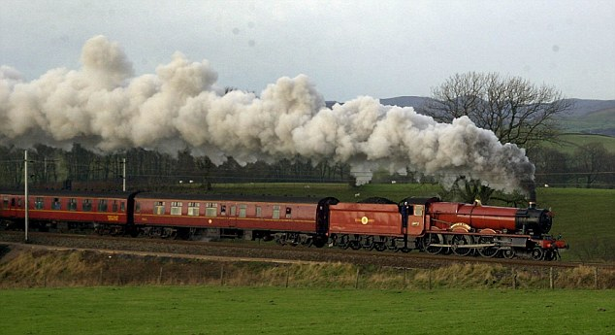
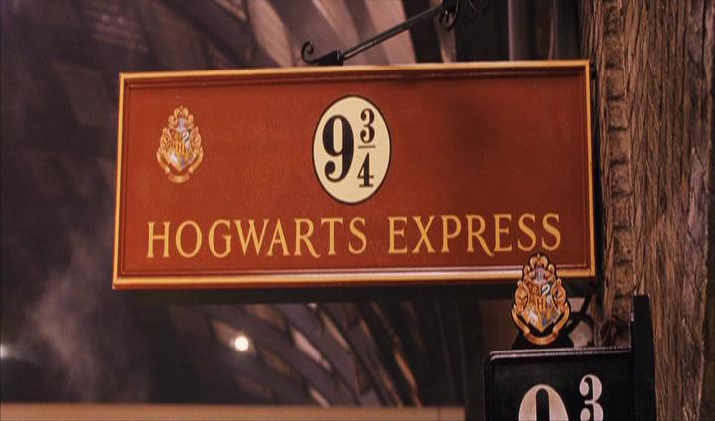
Logical layout of data
linear
non-linear

Slide 8
linear data structures
Contiguous: Arrays
Scattered: Linked lists

Slide 9
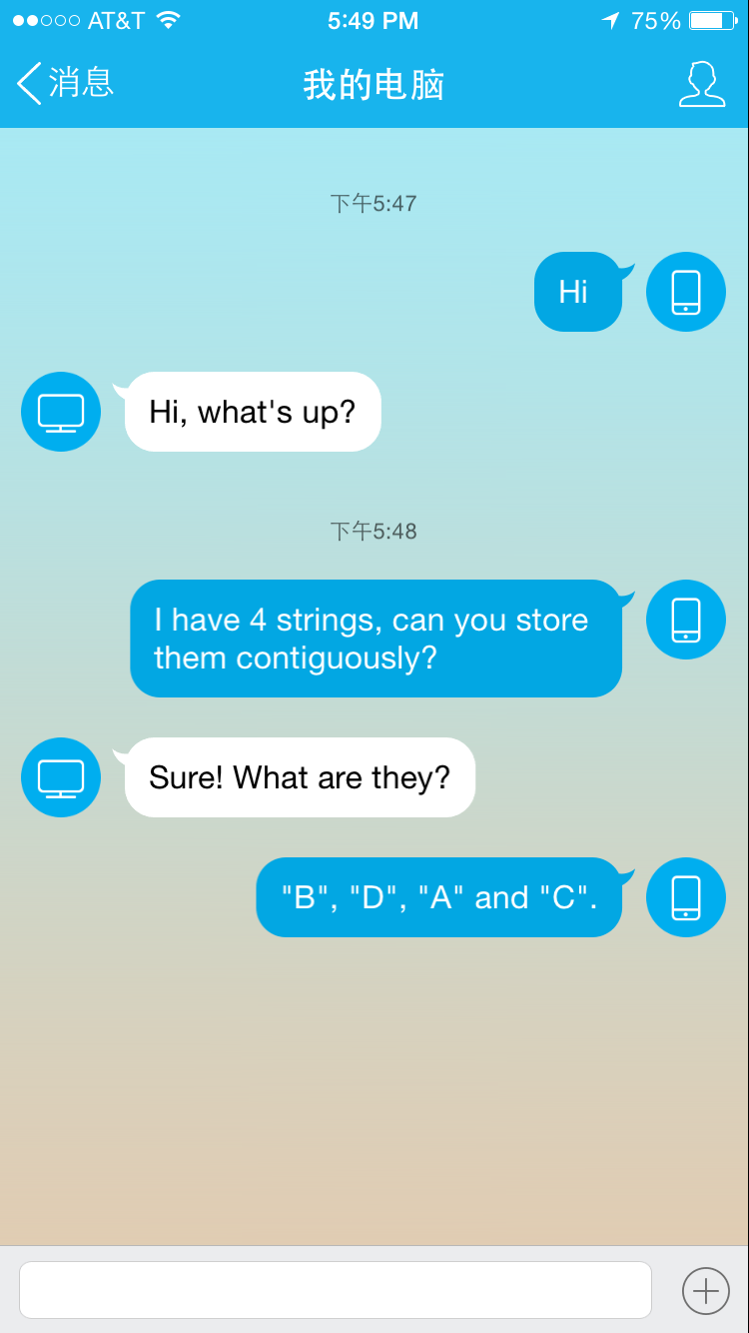
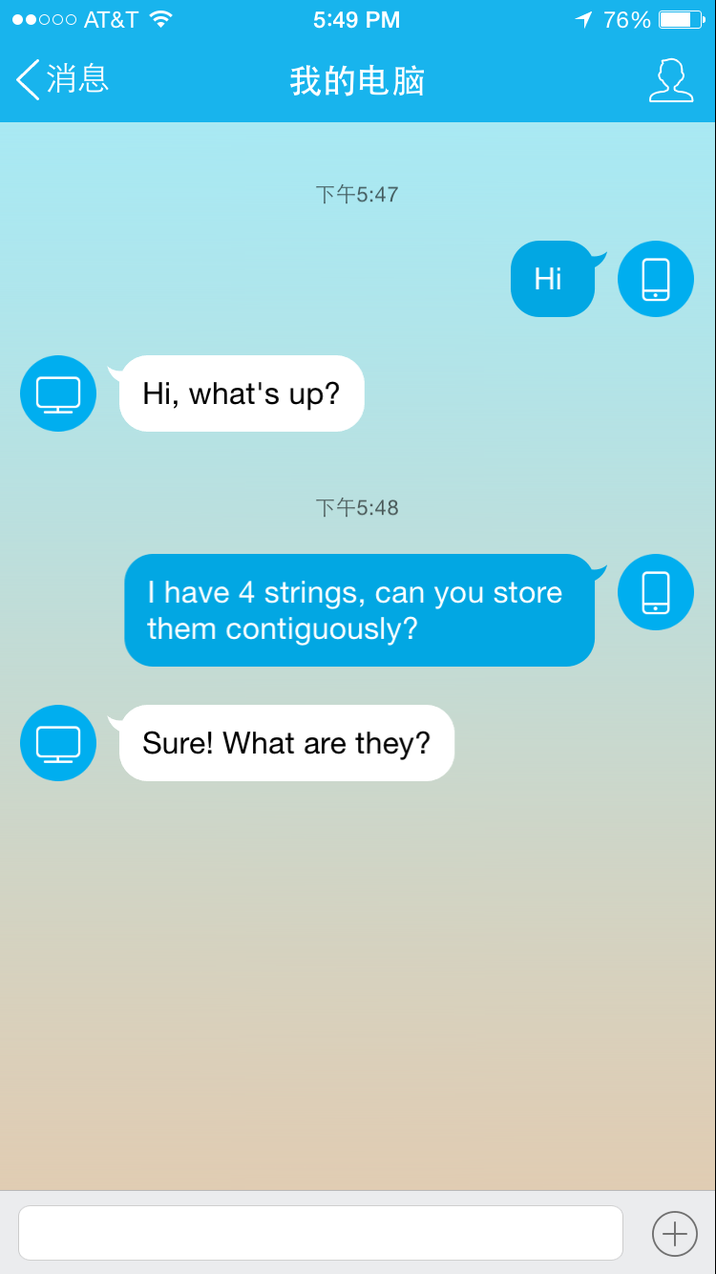
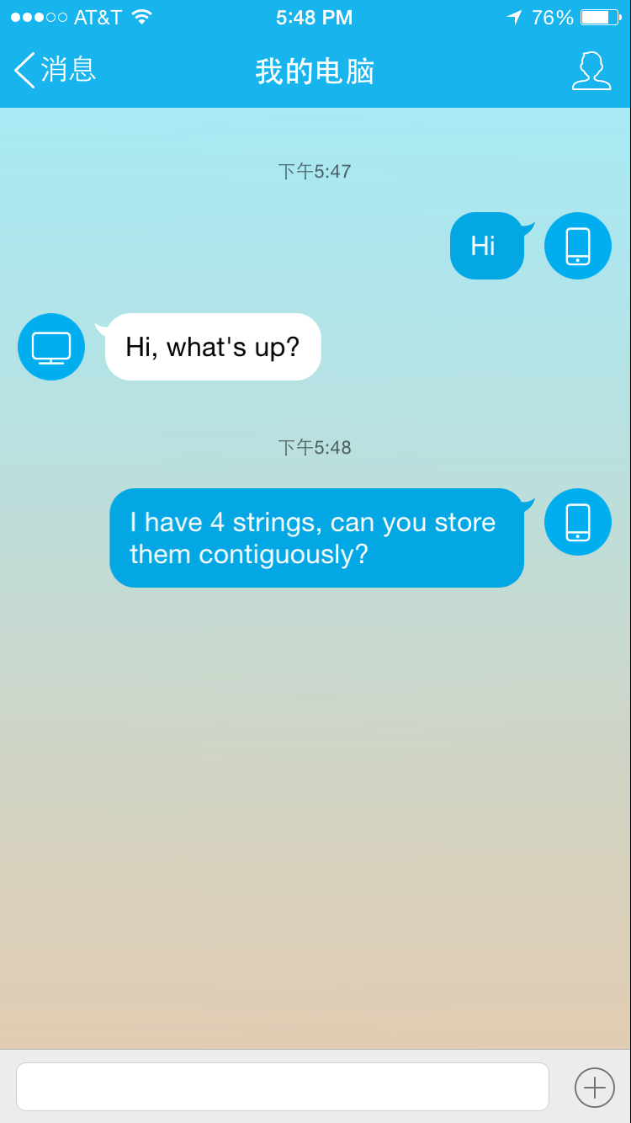
This is array.
B
D
A
C

Slide 10
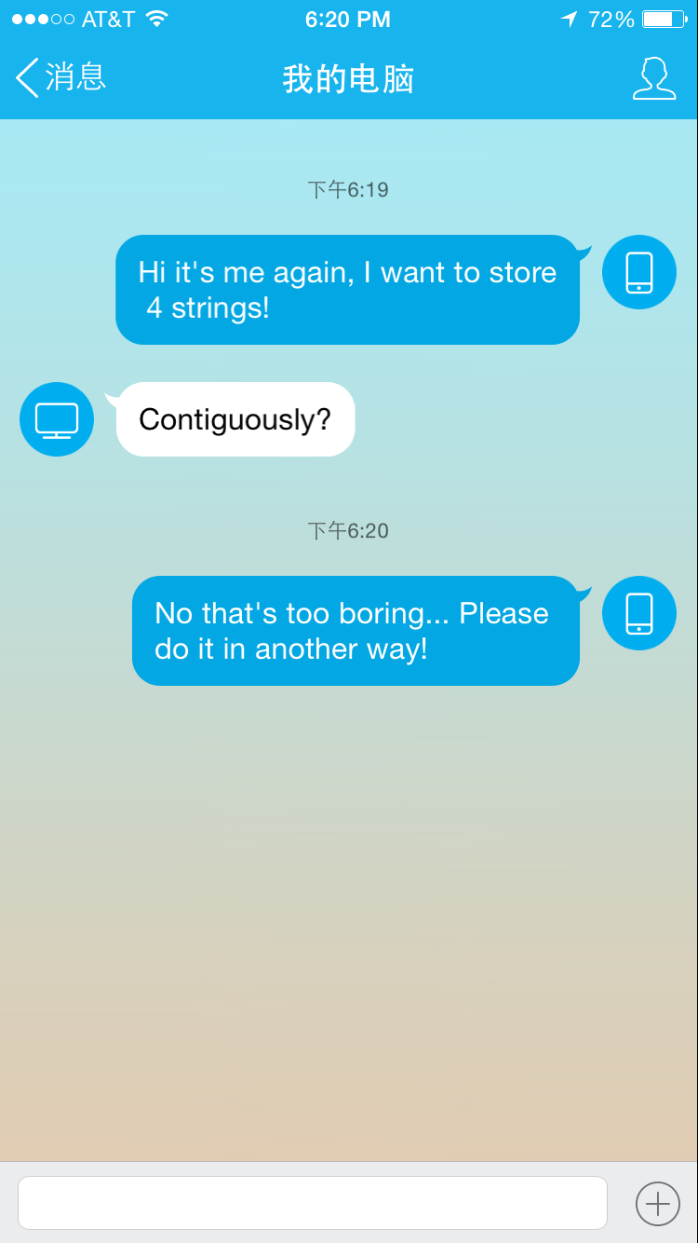
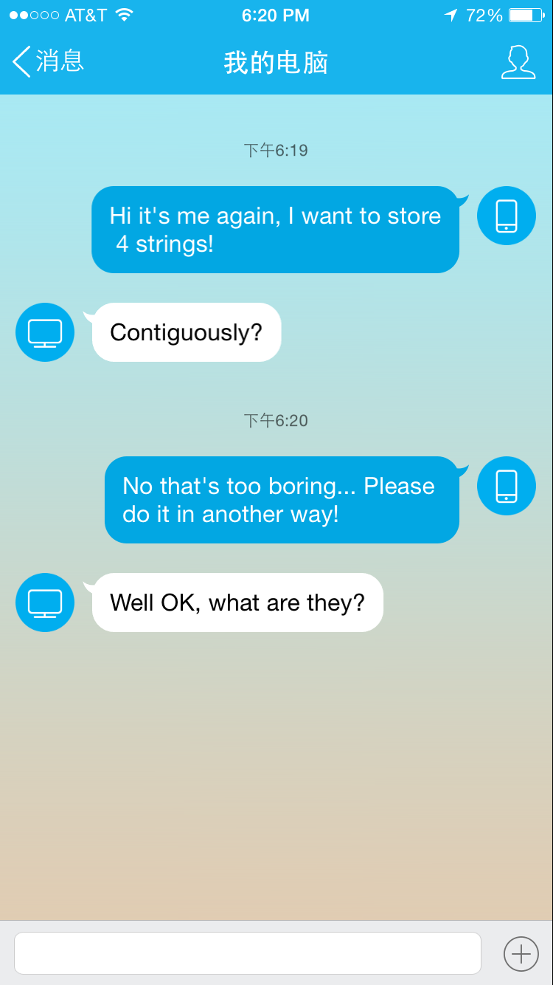
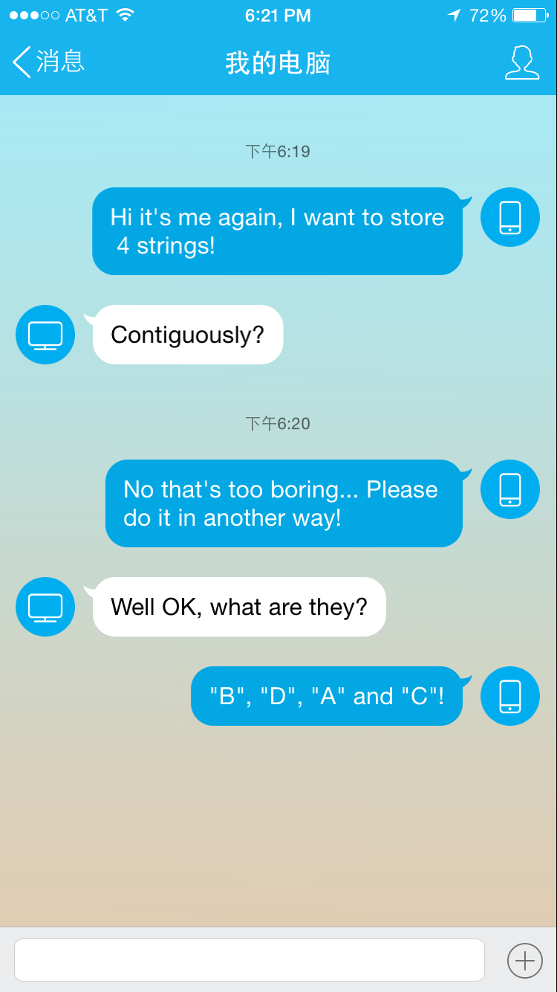
This is linked list.
h
B
D
A
C

Slide 11
Array vs. linked list

Slide 12
Memory Utilization
h
null
Random access
0x00F1
0x0051
Space complexity
B
0x00F1
0x0051
+0
0x00A9
0x00E4
B
D
A
C
+1
0x00E5
D
0x0051
0x00A9
0x50C1
+2
0x00E6
+3
0x00A9
0x00E7
A
0x50C1
0xABCD
Programming complexity
C
0x50C1
0xABCD
null
Insert & Delete

Slide 13
linear data structures
Contiguous: Arrays
Scattered: Linked lists
This is not enough.

Slide 14
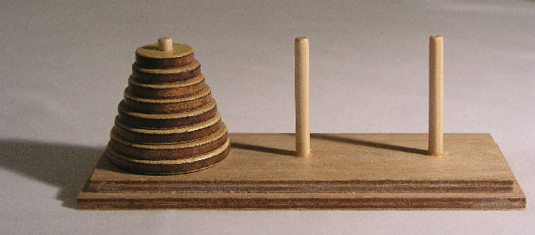
Tower of Hanoi
You cannot move the disk at the bottom without taking off the disks above it.
i.e. The last disk put on the rod has to be moved first.

Slide 15
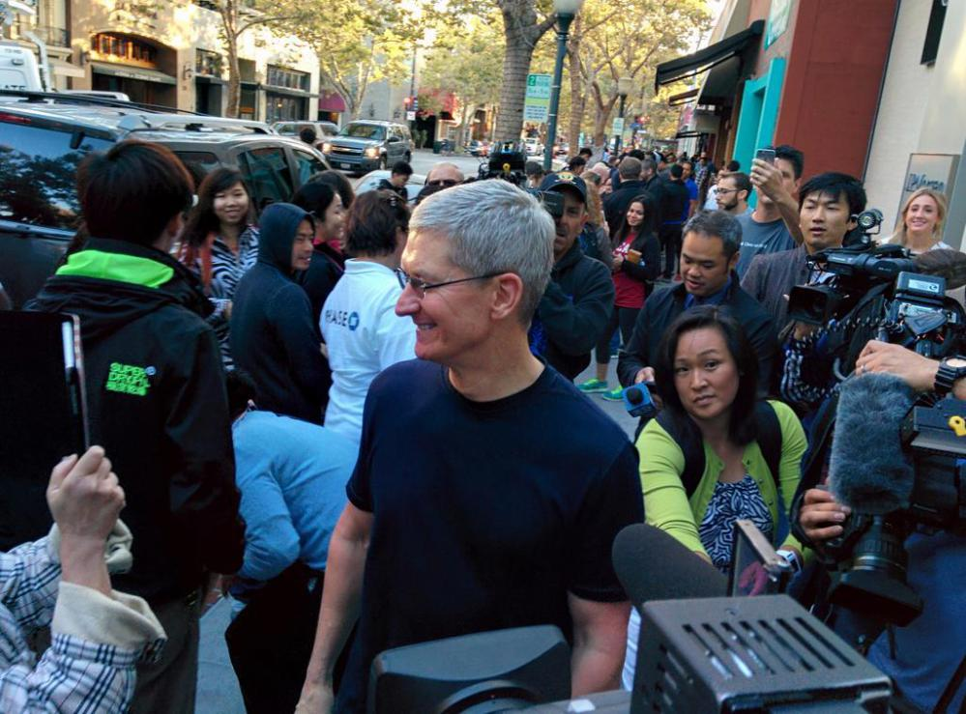
Apple: Bigger than bigger
Customers came first should be served first.

Slide 16
LIFO & FIFO
Last in first out: Stack
First in last out: Queue
They are restrictions that can be applied on both arrays and linked lists. When applied, those data structures can only add or remove elements in a certain way. (i.e. Stack and queue can be implemented by both array and linked list)

Slide 17
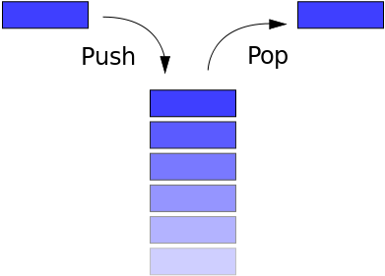
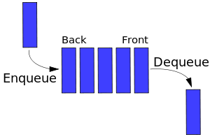
Stack
Queue

Slide 18
Usage of stack and queue
Stack:
Evaluate expressions (homework 3).
Recursion.
Queue:
Scheduling
Buffers, pipes…

Slide 19
Recursion
A recursion function must have:
An entrance (initial conditions)
A recurrence relation
An exit (cannot be a infinite loop)

Slide 20
Recursion
Think about a program that can print out first n Fibonacci numbers:
The entrance:
$$F_{1}=1 and F_{2}=1$$
The recurrence relation:
$$F_{i}=F_{i−1}+F_{i−2}$$
The exit:
$i=n$

Slide 21
I want to know $F_{5}…$
$$F_{5}=F_{4}+F_{3}$$
$$F_{4}=F_{3}+F_{2}$$
$$F_{1}=1, F_{2}=1$$
$$F_{3}=F_{2}+F_{1}=2$$
$$F_{3}=2$$
$$F_{4}=3$$
$$F_{5}=5$$
Recursion stack
$$F_{4}=F_{3}+1$$
$$F_{5}=F_{4}+F_{3}$$

Slide 22
Now let’s go beyond linear data structures

Slide 23
A singly linked list
 | 50
 | 17
 | 72
 | 12
 | 23
 | 54
 | 76
 | 19
 | 87
Each node has only one succeeding element.
Can they have more?
Definitely!
What does it look like?

Slide 24
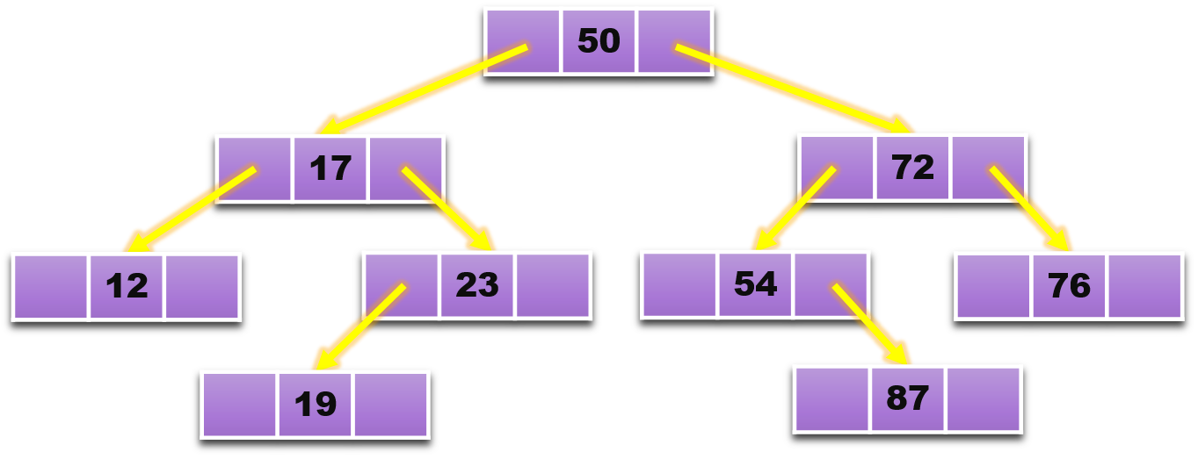

Slide 25
Root node
Inner node
Branch node
Outer node
Leaf node
If the heights of the two child sub-trees of any node differ by at most one, the binary tree is balanced (AVL).
If the key in any node is larger than the keys in all nodes in that node’s left sub-tree and smaller than the keys in all nodes in that node’s right sub-tree, the binary tree is sorted and is called binary search tree.
If each node has at most two children, the tree is a binary tree.
If every level, except possibly the last, is completely filled, and all nodes are as far left as possible, the binary tree is complete.
If every node other than the leaves has two children, the binary tree is full.
A full binary tree must be complete.
Height of a node: the length of the longest downward path to a leaf from that node.
Depth of a node: length of the path to its root.

Slide 26
Tree Traversal
Pre-order
In-order
Post-order
50, 17, 12, 23, 19, 72, 54, 87, 76
12, 17, 19, 23, 50, 54, 87, 72, 76
12, 19, 23, 17, 87, 54, 76, 72, 50

Slide 27
Graph
A graph is a representation of a set of objects where some pairs of objects are connected by links

Slide 28
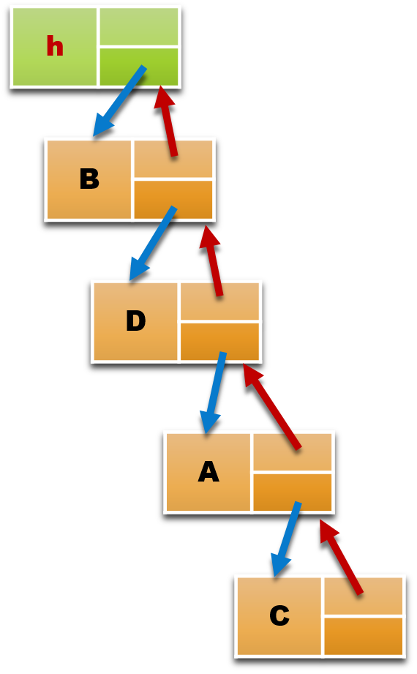
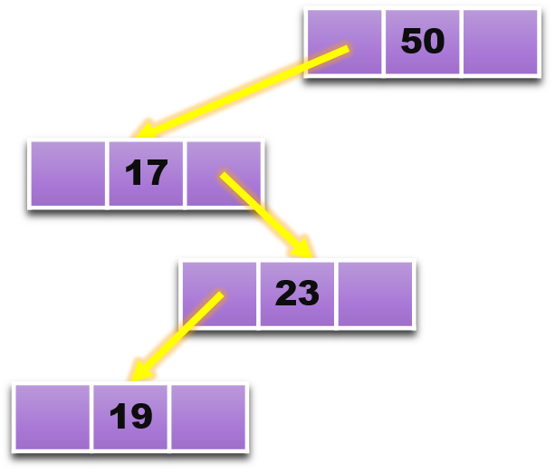
A graph is a representation of a set of objects where some pairs of objects are connected by links

Slide 29
They are all graphs!
Let’s do a comparison.

Slide 30
Freedom!
Graphs are composed of a set of vertices (nodes) and edges, just like linked lists and trees, but with graphs there are no rules for the connections between nodes!
 | Linked List | Tree | Graph
Can contain cycles | ✗ | ✗ | ✓
Can be disconnected | ✗ | ✗ | ✓
Multiple succeeding / child elements | ✗ | ✓ | ✓
Model | linear | hierarchical | network

Slide 31
What do they look like?
a
b
c
undirected
a can directly reach b, vice versa.
a
b
c
directed
a can directly reach b, but b cannot directly reach a.

Slide 32
What do they look like?
a
b
c
Directed acyclic
a
b
c
Directed cyclic

Slide 33
What do they look like?
a
b
c
connected
a
b
c
disconnected

Slide 34
What do they look like?
a
b
c
Sub-graph 1
d
e
f
Sub-graph 2
It can even consist of two disconnected parts!

Slide 35
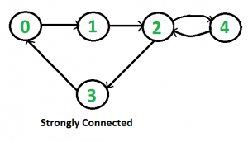
What do they look like?

Slide 36
More complicated?
e
d
f
a
c
g
b
h
j
i

Slide 37
Edges can have weights!
e
1
2
d
f
4
3
4
5
a
2
c
1
1
2
2
g
b
4
3
1
2
2
h
j
6
i
2

Slide 38
Much more complicated?
a
c
e
d
b
i
f
l
h
m
k
j
g
o
n

Slide 39
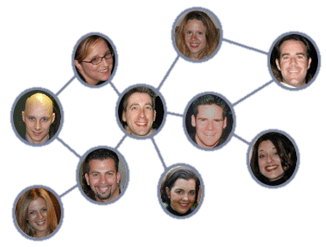
Something you use almost everyday?

Slide 40
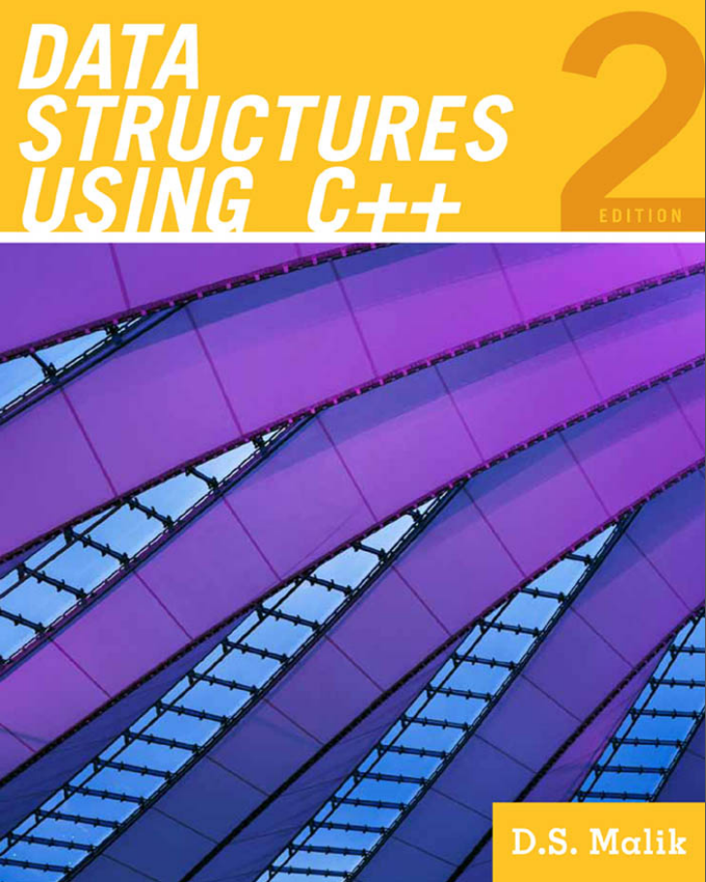
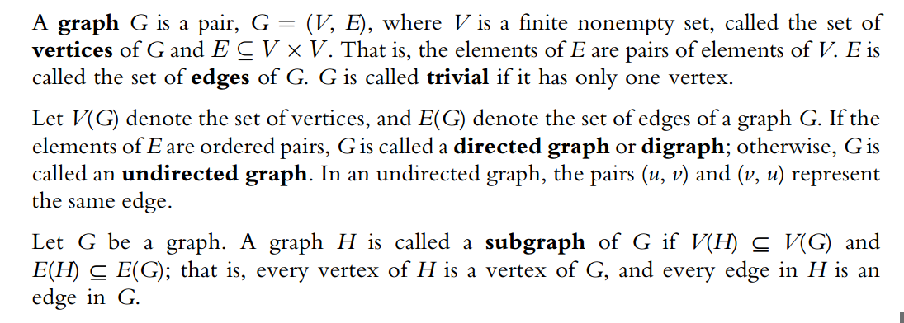
Let’s be more serious

Slide 41
a
b
c
$$G=(V, E)$$
$$V=\left\{a, b, c\right\}$$
$$E=\{\left(a,b\right), \left(b,c\right), (c, a)\}$$

Slide 42
In-degree and Out-degree
The in-degree of a vertex v is the number of edges with v as their terminal vertex.
The out-degree of a vertex v is the number of edges with v as their initial vertex.

Slide 43
In-degree
2
1
a
c
e
2
0
d
b
2
2
i
2
f
l
2
h
1
2
m
k
j
g
3
1
2
o
n
1
3

Slide 44
Out-degree
1
2
a
c
e
2
4
d
b
1
2
i
2
3
l
2
h
3
2
m
k
j
g
2
0
Sink
3
o
n
1
0
Sink

Slide 45
Now I know what is graph, then how to store it?

Slide 46
Adjacency Matrices

Slide 47
a
b
c
$$G=(V, E)$$
$$V=\left\{a, b, c\right\}$$
$$E=\{\left(a,b\right), \left(b,c\right), \left(c, b\right), (c, a)\}$$
$$n=3, so the adjacency matrix is 3×3.$$
a b c
a
b
c
$$\begin{matrix}0 & 1 & 0 \\ 0 & 0 & 1 \\ 1 & 1 & 0\end{matrix}$$

Slide 48
Adjacency Lists

Slide 49
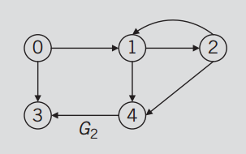
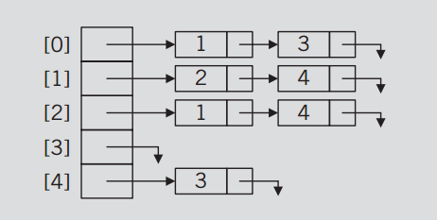

Slide 50
Which to choose?

Slide 51
Dense graph vs. Sparse graph
A graph is dense when the number of edges is close to the maximal number of edges.
The opposite, a graph with only a few edges, is a sparse graph.
A directed graph can have at most $n\left(n−1\right)$edges, while a undirected graph can have at most $\frac{n\left(n−1\right)}{2}$ edges.

Slide 52
a b c
a
b
c
$$\begin{matrix}0 & 1 & 0 \\ 0 & 0 & 1 \\ 1 & 1 & 0\end{matrix}$$
If a graph is sparse, its adjacency matrix will have a lot of 0’s which are useless and wasting a lot of memory space.
If a graph is dense, each node in its adjacency list will be linked to a very long linked list. Traversing will be very inefficient
So it’s better to use adjacency list when the graph is sparse, use adjacency matrix if the graph is dense.

Slide 53
Traversing a graph
Depth-First Traversal: It is like pre-order traversal of trees. Go as deep as possible.
Edge based: using stack.
Breadth-First Traversal: It’s like traversing a binary tree level-by-level. (The nodes at each level are visited from left to right.)
Vertex based: using queue.

Slide 54
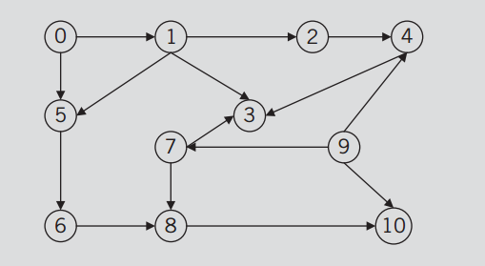
Depth-first Traversal
Start from 0.
0
5
6
8
10
1
3
2
4
7
9
Not visited
Visited
10
3
5
6
8
4
9
3
1
3
8
2
5
7
0
stack

Slide 55
Breadth-first Traversal

Slide 56
Well then…

Slide 57
Data
Structure
Linear
Linear
Structure
Contiguous
Array
Scattered
Linked List
More succeeding
elements
Tree
LIFO
FIFO
Cycles
Disconnected
Stack
Queue
DFS
Graph
BFS
Expression
evaluation
Recursion
Infix to postfix

